Slide 1

Course Code: CSE 2203
Course Title: Digital Techniques
Heaven’s Light is Our Guide
Department of Computer Science & Engineering
Rajshahi University of Engineering & Technology, Bangladesh
Date : 29.08.2017
Session : IV
Topic : Boolean Algebra and Logic Gates
Faculty : Dr. Boshir Ahmed
Professor
Department of CSE, RUET
E mail: boshir78@gmail.com

Slide 2
Boolean Algebra
In order to analyze and design digital combinational logic circuits we need a mathematical system.
Binary logic system called Boolean Algebra is used.
George Boole (1815-1864): “An investigation of the laws of thought” – a book published in 1854 introducing the mathematical theory of logic.
Boolean Algebra deals with binary variables that take 2
discrete values (0 and 1), and with logic operations.
Binary/logic variables are typically represented as letters: A,B,C,…,X,Y,Z or a,b,c,…,x,y,z.
Three basic logic operations:
 AND, OR, NOT (complementation).

Slide 3
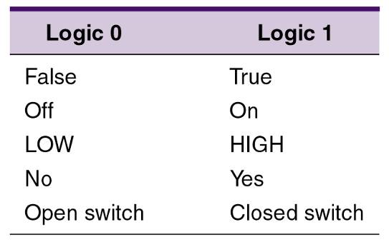
Boolean Constants and Variables
Boolean algebra allows only two values—0 and 1.
  Logic 0 can be: false, off, low, no, open switch.
  Logic 1 can be: true, on, high, yes, closed switch.
The three basic logic operations:
  OR, AND, and NOT.

Slide 4
Truth Tables
A truth table describes the relationship between the input and output of a logic circuit.
The number of entries corresponds to the number of inputs.
  A 2-input table would have 2² = 4 entries.
  A 3-input table would have 2³ = 8 entries.

Slide 5
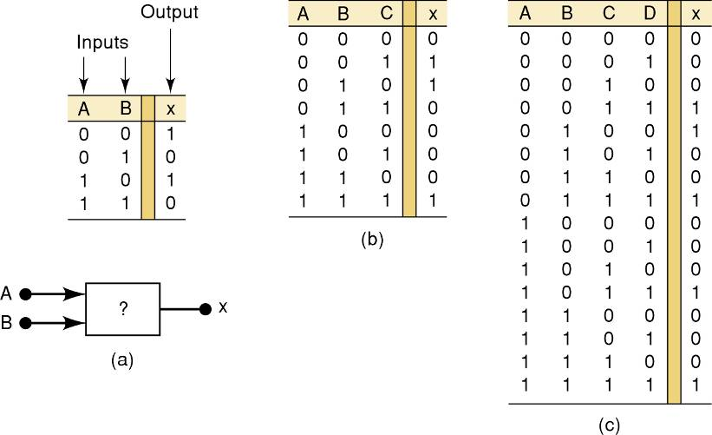
Truth Tables
Examples of truth tables with 2, 3, and 4 inputs.

Slide 6
OR Operation With OR Gates
The Boolean expression for the OR operation is:
    X = A + B — Read as “X equals A OR B”
The + sign does not stand for ordinary
addition—it stands for the OR operation
The OR operation is similar to addition, but when A = 1 and B = 1, the OR operation produces:
1 + 1 = 1 not 1 + 1 = 2
In the Boolean expression x = 1 + 1 + 1 = 1…
    x is true (1) when A is true (1) OR B is true (1) OR C is true (1)

Slide 7
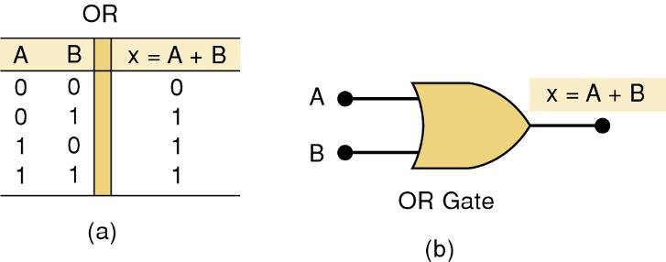
OR Operation With OR Gates
An OR gate is a circuit with two or more inputs, whose output is equal to the OR combination
of the inputs.
Truth table/circuit symbol for a two input OR gate.

Slide 8
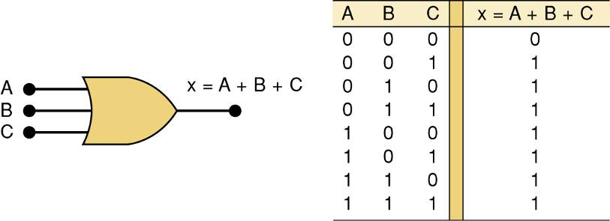
OR Operation With OR Gates
An OR gate is a circuit with two or more inputs, whose output is equal to the OR combination
of the inputs.
Truth table/circuit symbol for a three input OR gate.

Slide 9
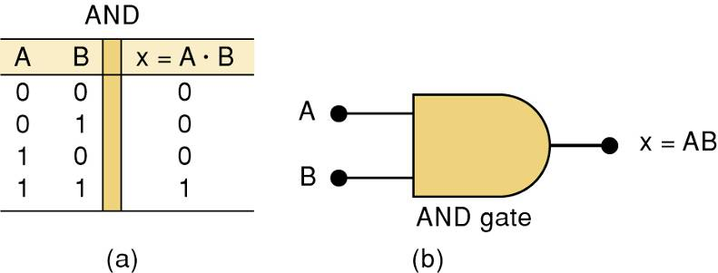
AND Operations with AND gates
The AND operation is similar to multiplication:
X = A • B • C — Read as “X equals A AND B AND C”
The + sign does not stand for ordinary
multiplication—it stands for the AND operation.
    x is true (1) when A AND B AND C are true (1)
Truth table — Gate symbol.

Slide 10
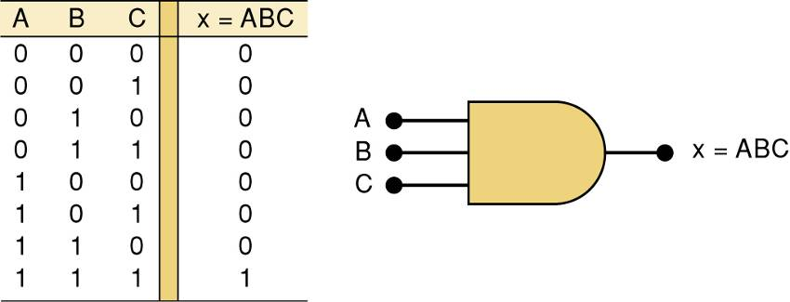
AND Operations with AND gates
Truth table/circuit symbol for a three input AND gate.

Slide 11
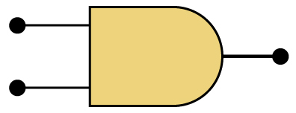
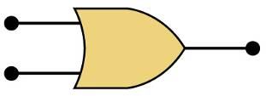
AND / OR
The AND symbol on a logic-circuit diagram tells you output will go HIGH only
when all inputs are HIGH.
The OR symbol means the output will go HIGH when
any input is HIGH.

Slide 12
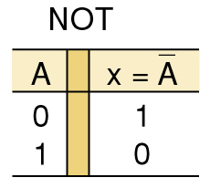
NOT Operation
The Boolean expression for the NOT operation:
X = A
— Read as:
“X equals NOT A”
“X equals the inverse of A”
“X equals the complement of A”
The overbar represents
the NOT operation.
A' = A
Another indicator for inversion is the
prime symbol (').
    NOT Truth Table

Slide 13
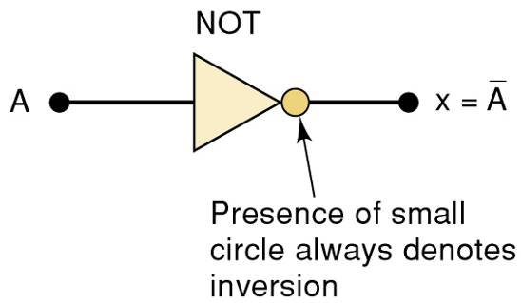
NOT Operation
A NOT circuit—commonly called an INVERTER.
This circuit always has only a single input, and the out-put
logic level is always opposite to the logic level of this input.

Slide 14
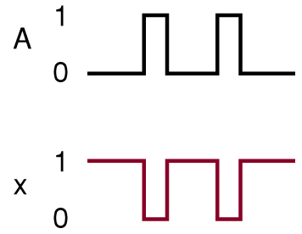
NOT Operation
The INVERTER inverts (complements) the
input signal at all points on the waveform.
Whenever the input = 0, output = 1, and vice versa.

Slide 15
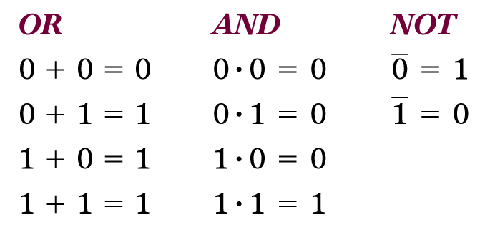
Boolean Operations
Summarized rules for OR, AND and NOT
These three basic Boolean operations
can describe any logic circuit.

Slide 16
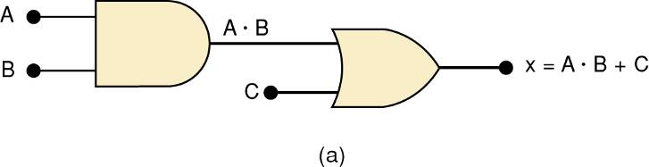
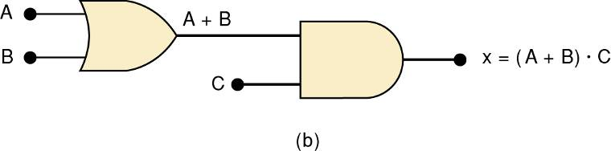
Describing Logic Circuits Algebraically
If an expression contains both AND and OR gates, the AND operation will be performed first.
Unless there is a parenthesis in the expression.

Slide 17
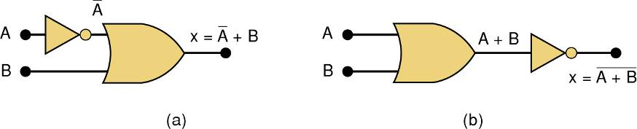
Describing Logic Circuits Algebraically
Whenever an INVERTER is present, output is equivalent to input, with a bar over it.
  Input A through an inverter equals A.

Slide 18
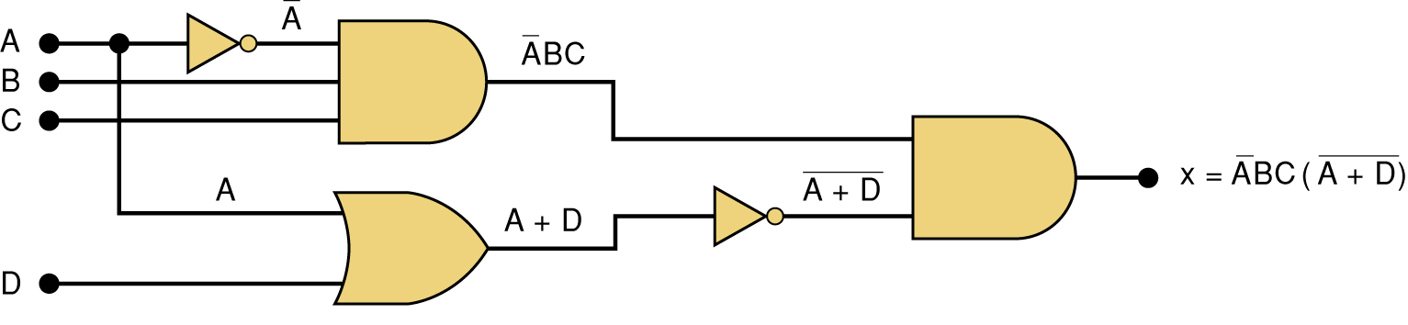
Describing Logic Circuits Algebraically
Further examples…

Slide 19
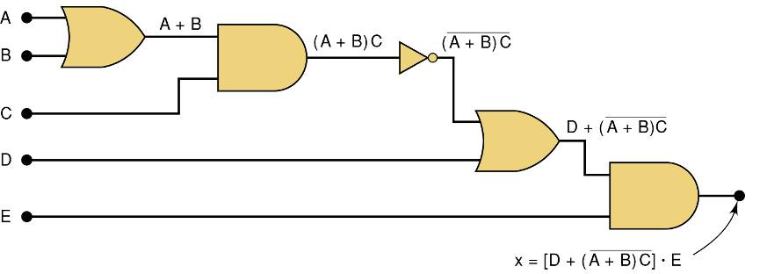
Describing Logic Circuits Algebraically
Further examples…

Slide 20
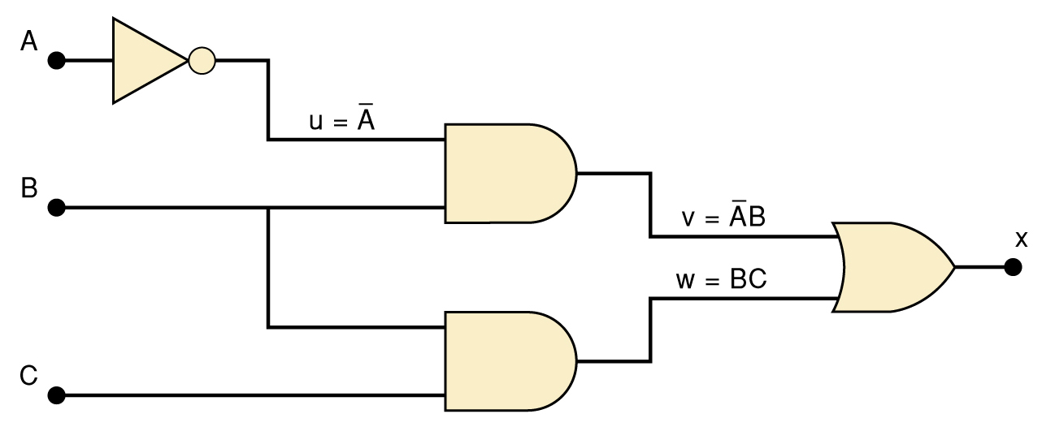
Evaluating Logic Circuit Outputs
The best way to analyze a circuit made up of multiple logic gates is to use a truth table.
  It allows you to analyze one gate or logic
  combination at a time.
  It allows you to easily double-check your work.
  When you are done, you have a table of tremendous benefit in troubleshooting the logic circuit.

Slide 21
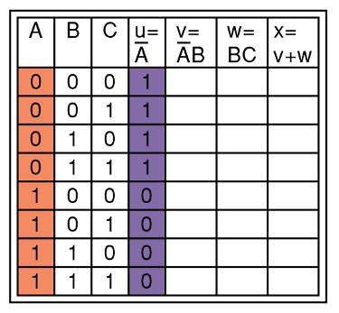
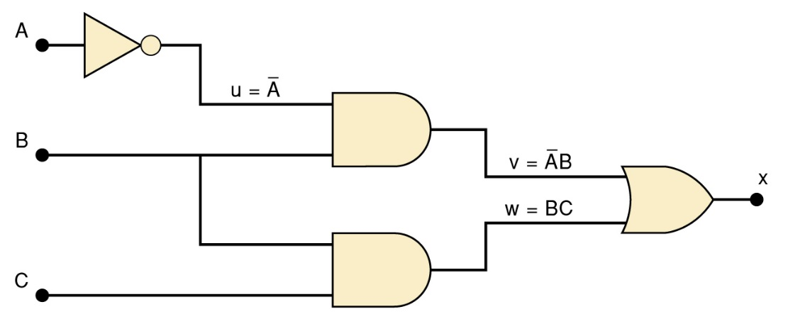
Evaluating Logic Circuit Outputs
The first step after listing all input combinations
is to create a column in the truth table for each intermediate signal (node).
Node u has been filled as the complement of A

Slide 22
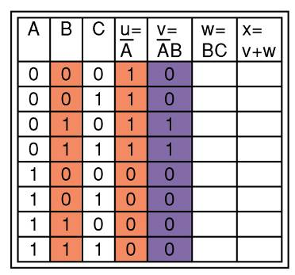
Evaluating Logic Circuit Outputs
The next step is to fill in the values for column v.
v =AB — Node v should be HIGH
when A (node u) is HIGH AND B is HIGH

Slide 23
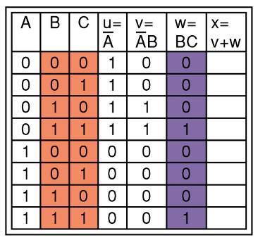
Evaluating Logic Circuit Outputs
The third step is to predict the values at node w which is the logical product of BC.
This column is HIGH whenever B is HIGH AND C is HIGH

Slide 24
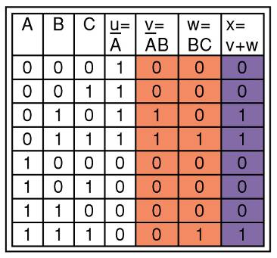
Evaluating Logic Circuit Outputs
The final step is to logically combine columns v and w to predict the output x.
Since x = v + w, the x output will be HIGH when v OR w is HIGH

Slide 25
Evaluating Logic Circuit Outputs
Output logic levels can be determined directly from a circuit diagram.
  Output of each gate is noted until final output is found.
    Technicians frequently use this method.

Slide 26
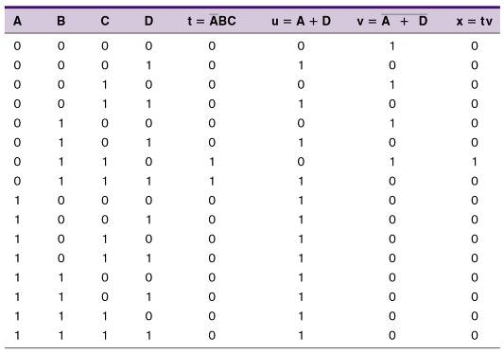
Evaluating Logic Circuit Outputs
Table of logic state
at each node of the
circuit shown.

Slide 27
Implementing Circuits From Boolean Expressions
It is important to be able to draw a logic circuit from a Boolean expression.
  The expression X = A • B • C, could be drawn
  as a three input AND gate.
  A circuit defined by X = A + B, would use a two-input OR gate with an INVERTER on one of
  the inputs.

Slide 28
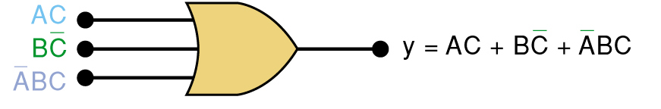
Implementing Circuits From Boolean Expressions
A circuit with output y = AC + BC + ABC
contains three terms which are ORed together.
…and requires a three-input OR gate.

Slide 29
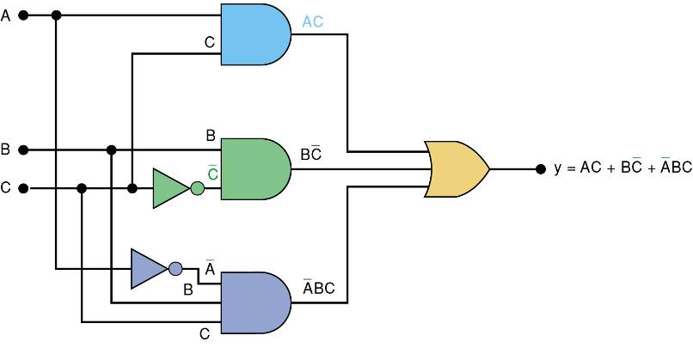
Implementing Circuits From Boolean Expressions
Each OR gate input is an AND product term,
  An AND gate with appropriate inputs can be
  used to generate each of these terms.

Slide 30
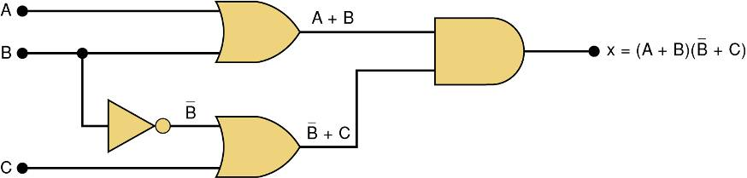
Implementing Circuits From Boolean Expressions
Circuit diagram to implement x = (A + B) (B + C)

Slide 31
NOR Gates and NAND Gates
Combine basic AND, OR, and NOT operations.
  Simplifying the writing of Boolean expressions
Output of NAND and NOR gates may be found
by determining the output of an AND or OR
gate, and inverting it.
  The truth tables for NOR and NAND gates show the complement of truth tables for OR and AND gates.

Slide 32
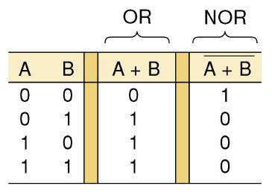
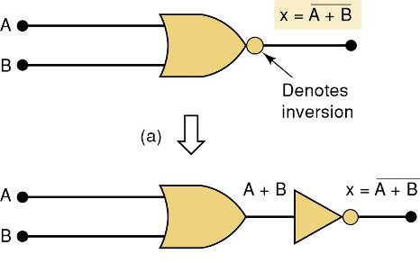
NOR Gates and NAND Gates
The NOR gate is an inverted OR gate.
  An inversion “bubble” is placed at the output
  of the OR gate, making the Boolean output expression x = A + B

Slide 33
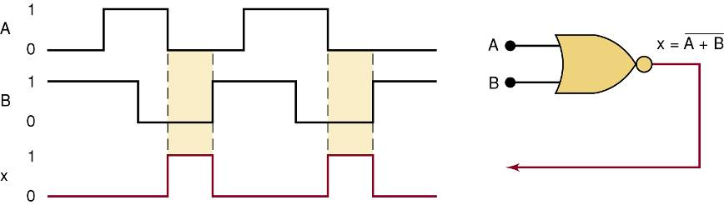
NOR Gates and NAND Gates
Output waveform of a NOR gate for
the input waveforms shown here.

Slide 34
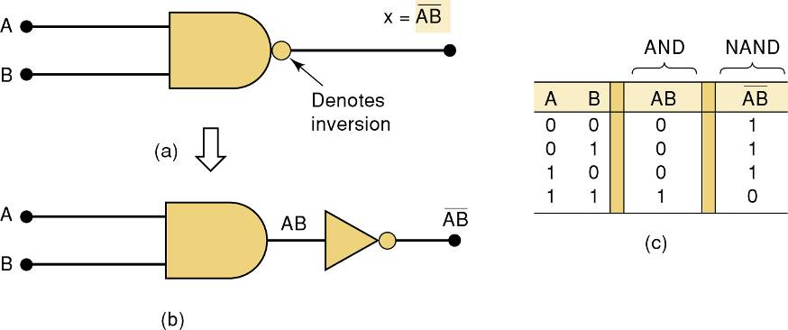
NOR Gates and NAND Gates
The NAND gate is an inverted AND gate.
  An inversion “bubble” is placed at the output
  of the AND gate, making the Boolean output
  expression x = AB

Slide 35
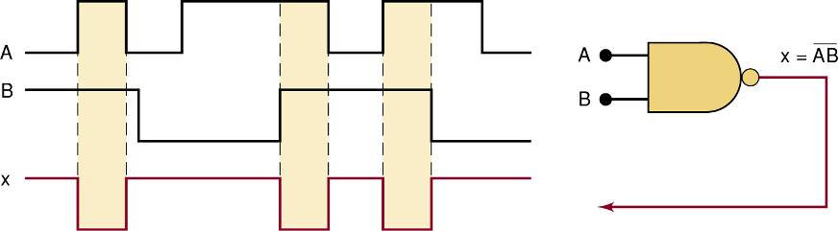
NOR Gates and NAND Gates
Output waveform of a NAND gate for
the input waveforms shown here.

Slide 36
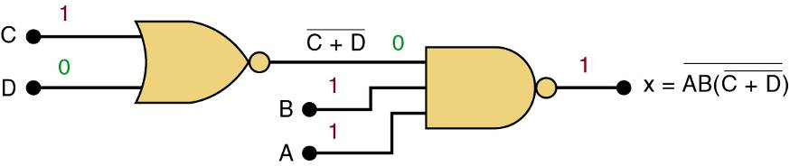
NOR Gates and NAND Gates
Logic circuit with the expression x = AB • (C + D)
using only NOR and NAND gates.

Slide 37
Boolean Theorems
The theorems or laws that follow may represent an expression containing more than one variable.

Slide 38
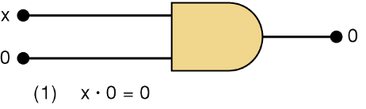
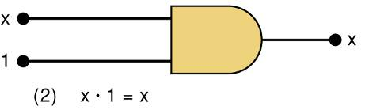
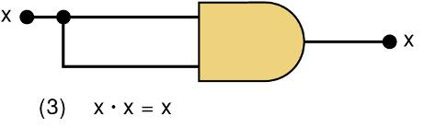
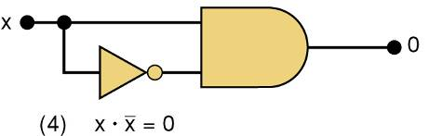
Boolean Theorems
Theorem (1) states that if any variable
is ANDed with 0, the result must be 0.
Theorem (2) is also obvious
by comparison with ordinary
multiplication.
Prove Theorem (3) by trying each case.
If x = 0, then 0 • 0 = 0
If x = 1, then 1 • 1 = 1
Thus, x • x = x
Theorem (4) can be proved
in the same manner.

Slide 39
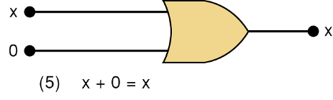
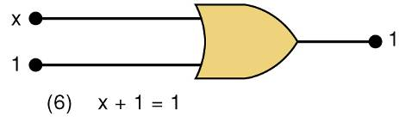
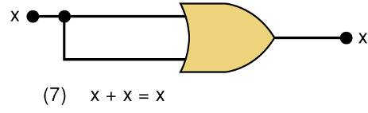
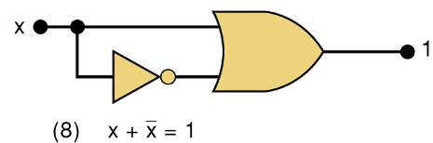
Boolean Theorems
Theorem (5) is straightforward,
as 0 added to anything does not affect value, either in regular addition or in OR addition.
Theorem (6) states that if any variable
is ORed with 1, the is always 1.
Check values: 0 + 1 = 1 and 1 + 1 = 1.
Theorem (7) can be proved by
checking for both values of x:
0 + 0 = 0 and 1 + 1 = 1.
Theorem (8) can be proved similarly.

Slide 40
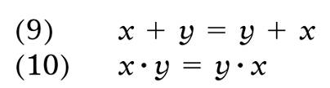


Boolean Theorems
Multivariable Theorems
Commutative laws
Associative laws
Distributive law

Slide 41
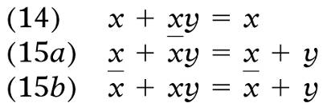
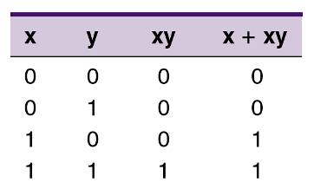

Boolean Theorems
Multivariable Theorems
Theorems (14) and (15) do not have counterparts
in ordinary algebra. Each can be proved by
trying all possible cases for x and y.
Analysis table & factoring
for Theorem (14)

Slide 42
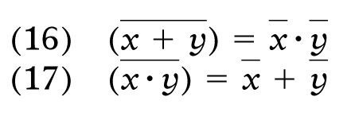
DeMorgan’s Theorems
DeMorgan’s theorems are extremely useful in simplifying expressions in which a product or
sum of variables is inverted.
Theorem (16) says inverting the OR sum of two variables is the same as inverting each variable individually, then ANDing the inverted variables.
Theorem (17) says inverting the AND product of two variables is the
same as inverting each variable individually and then ORing them.
Each of DeMorgan’s theorems can readily be proven by checking for all possible combinations of x and y.

Slide 43
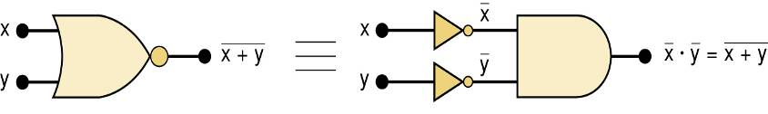
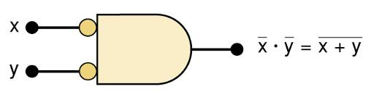
DeMorgan’s Theorems
Equivalent circuits implied by Theorem (16)
The alternative symbol
for the NOR function.

Slide 44
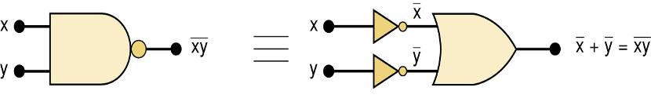
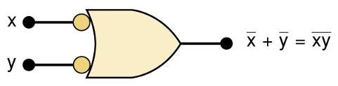
DeMorgan’s Theorems
Equivalent circuits implied by Theorem (17)
The alternative symbol
for the NAND function.

Slide 45
Universality of NAND and NOR Gates
NAND or NOR gates can be used to create the three basic logic expressions.
  OR, AND, and INVERT.
    Provides flexibility—very useful in logic circuit design.

Slide 46
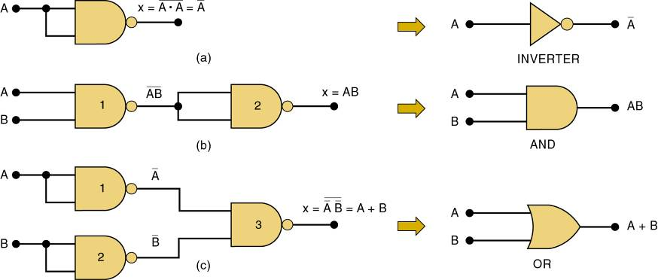
Universality of NAND and NOR Gates
How combinations of NANDs or NORs are
used to create the three logic functions.
It is possible, however, to implement any logic expression using only NAND gates and no other type of gate, as shown.

Slide 47

Universality of NAND and NOR Gates
How combinations of NANDs or NORs are
used to create the three logic functions.
NOR gates can be arranged to implement
any of the Boolean operations, as shown.

Slide 48

Universality of NAND and NOR Gates
A logic circuit to generate a signal x, that will go HIGH whenever conditions A and B exist simultaneously, or whenever conditions C and D exist simultaneously.
The logic expression will be x = AB + CD.
Each of the TTL ICs shown here will fulfill the function. Each IC is a quad, with four identical gates on one chip

Slide 49



Universality of NAND and NOR Gates
Possible Implementations # 1

Slide 50


Universality of NAND and NOR Gates
Possible Implementations #2

Slide 51
Exclusive OR and Exclusive NOR Circuits
The exclusive OR (XOR) produces a HIGH output whenever the two inputs are at
opposite levels.

Slide 52


Exclusive OR and Exclusive NOR Circuits
Exclusive OR circuit and truth table.
Output expression:
x = AB + AB
This circuit produces a HIGH output whenever the two inputs are at opposite levels.

Slide 53


Exclusive OR and Exclusive NOR Circuits
Traditional XOR gate symbol.
An XOR gate has only two inputs, combined so that x = AB + AB.
A shorthand way indicate the XOR output expression is:
x = A B.
…where the symbol represents the XOR gate operation.
Output is HIGH only when the two inputs are at different levels.
Quad XOR chips containing four XOR gates.
74LS86 Quad XOR (TTL family)
74C86 Quad XOR (CMOS family)
74HC86 Quad XOR (high-speed CMOS)

Slide 54
Exclusive OR and Exclusive NOR Circuits
The exclusive NOR (XOR) produces a HIGH output whenever the two inputs are at the
same level.
  XOR and XNOR outputs are opposite.

Slide 55


Exclusive OR and Exclusive NOR Circuits
Exclusive NOR circuit and truth table.
Output expression:
x = AB + AB
XNOR produces a HIGH output whenever
the two inputs are at the same levels.

Slide 56

Exclusive OR and Exclusive NOR Circuits
Traditional XNOR gate symbol.
An XNOR gate has only two inputs, combined so that x = AB + AB.
A shorthand way indicate the XOR output expression is:
x = A B.
XNOR represents inverse of the XOR operation.
Output is HIGH only when the two inputs are at the same level.
Quad XNOR chips with four XNOR gates.
74LS266 Quad XNOR (TTL family)
74C266 Quad XOR (CMOS)
74HC266 Quad XOR (high-speed CMOS)

Slide 57

Alternate Logic-Gate Representations
To convert a standard symbol to an alternate:
  Invert each input and output in standard symbols.
    Add an inversion bubble where there are none.
    Remove bubbles where they exist.

Slide 58
Alternate Logic-Gate Representations
Active-HIGH – an input/output has no inversion bubble.
Active-LOW – an input or output has an inversion bubble.

Slide 59

Alternate Logic-Gate Representations
Interpretation of the two NAND gate symbols.

Slide 60

Alternate Logic-Gate Representations
Interpretation of the two OR gate symbols.

Slide 61




Which Gate Representation to Use
Proper use of alternate gate symbols in the circuit diagram can make circuit operation much clearer.
Original circuit using standard NAND symbols.
Equivalent representation
where output Z is
active-HIGH.
Equivalent representation where output Z is
active-LOW.

Slide 62
Which Gate Representation to Use
When a logic signal is in the active state (HIGH or LOW) it is said to be asserted.
When a logic signal is in the inactive state (HIGH or LOW) it is said to be unasserted.
A bar over a signal means asserted (active) LOW.
Absence of a bar means asserted (active) HIGH
RD
RD

Slide 63

Thank You

